Slide 1
Pragmatica Light 60 PT
Pragmatica Light
60 PT
PRAGMATICA LIGHT 60 PT

Slide 2
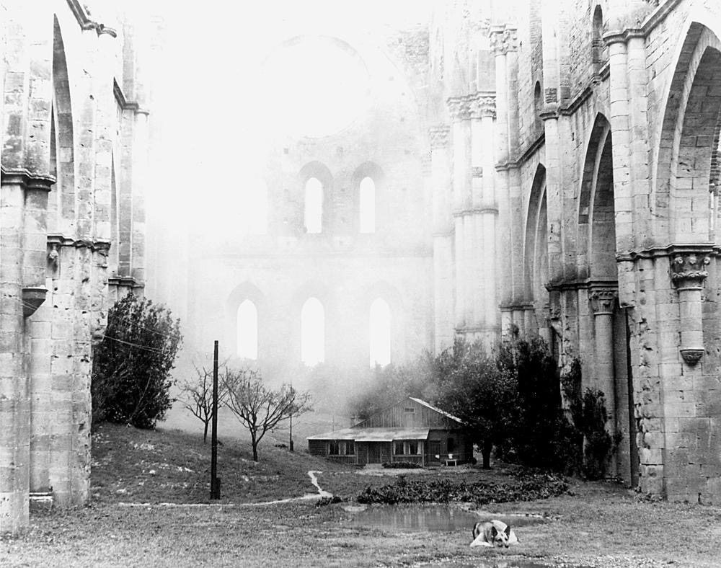
Pragmatica Light 60 PT
Pragmatica Light
60 PT

Slide 3
PRAGMATICA MEDIUM 36 PT
RGB 236 117 115
Text in Pragmatica Medium 24 pt
- Procurement policy implemented
- Fixed asset management policy implemented
- Accounting policy implemented
- Grant Thornton Baltics selected for 2 years to conduct audit of financial statements and of the budget implementation
- Procedures to maintain continuous follow-up for University leadership regarding cash-flow and implementation of audit recommendations
New IT systems being installed through SIDA’s support
max. (RGB 21 59 131)

Slide 4
Pragmatica Light 60 PT
RGB 236 117 115

Slide 5
Pragmatica Light 60 PT
Pragmatica Light
60 PT
PRAGMATICA LIGHT 60 PT LIGHT 60 PT LIGHT 60 PT LIGHT 60 PT

Slide 6
PRAGMATICA LIGHT 60 PT Former concerns:
insufficient excellence and loss
of
momentum
PRAGMATICA MEDIUM 36 PT
RGB 236 117 115
Text in Pragmatica Medium 24 pt
- Procurement policy implemented
- Fixed asset management policy implemented
- Accounting policy implemented
- Grant Thornton Baltics selected for 2 years to conduct audit of financial statements and of the budget implementation
- Procedures to maintain continuous follow-up for University leadership regarding cash-flow and implementation of audit recommendations
New IT systems being installed through SIDA’s support
max. (RGB 21 59 131)

Slide 7
PRAGMATICA LIGHT 60 PT Former concerns:
insufficient excellence and loss
of
momentum
PRAGMATICA MEDIUM 36 PT
RGB 236 117 115
Text in Pragmatica Medium 24 pt
- Procurement policy implemented
- Fixed asset management policy implemented
- Accounting policy implemented
- Grant Thornton Baltics selected for 2 years to conduct audit of financial statements and of the budget implementation
- Procedures to maintain continuous follow-up for University leadership regarding cash-flow and implementation of audit recommendations
New IT systems being installed through SIDA’s support
max. (RGB 21 59 131)

Slide 8
PRAGMATICA LIGHT 60 PT Former concerns:
insufficient excellence and loss
of
momentum
PRAGMATICA MEDIUM 36 PT
RGB 236 117 115
Text in Pragmatica Medium 24 pt
- Procurement policy implemented
- Fixed asset management policy implemented
- Accounting policy implemented
- Grant Thornton Baltics selected for 2 years to conduct audit of financial statements and of the budget implementation
- Procedures to maintain continuous follow-up for University leadership regarding cash-flow and implementation of audit recommendations
New IT systems being installed through SIDA’s support
max. (RGB 21 59 131)

Slide 9
PRAGMATICA LIGHT 60 PT Former concerns:
insufficient excellence and loss
of
momentum
PRAGMATICA MEDIUM 36 PT
RGB 236 117 115
Text in Pragmatica Medium 24 pt
- Procurement policy implemented
- Fixed asset management policy implemented
- Accounting policy implemented
- Grant Thornton Baltics selected for 2 years to conduct audit of financial statements and of the budget implementation
- Procedures to maintain continuous follow-up for University leadership regarding cash-flow and implementation of audit recommendations
New IT systems being installed through SIDA’s support
max. (RGB 21 59 131)

Slide 10
Pragmatica Light
RGB 236 117 115
Pragmatica light 36 pt
RGB 21 59 131

Slide 11
Pragmatica Light
RGB 236 117 115
Pragmatica light 36 pt
RGB 21 59 131

Slide 12
PRAGMATICA LIGHT 60 PT Former concerns:
insufficient excellence and loss
of
momentum
PRAGMATICA MEDIUM 36 PT RGB 236 117 115
Text in Pragmatica Medium 24 pt
- Procurement policy implemented
- Fixed asset management policy implemented
- Accounting policy implemented
Grant Thornton Baltics selected for 2 years to conduct audit of financial statements and of the budget implementationNew IT systems being installed through SIDA’s support
max. (RGB 21 59 131)

Slide 13
PRAGMATICA MEDIUM 36 PT RGB 236 117 115
Text in Pragmatica Medium 24 pt
- Procurement policy implemented
- Fixed asset management policy implemented
- Accounting policy implemented
Grant Thornton Baltics selected for 2 years to conduct audit of financial statements and of the budget implementationNew IT systems being installed through SIDA’s support
max. (RGB 21 59 131)
PRAGMATICA LIGHT 60 PT Former concerns:
insufficient excellence and loss
of
momentum

Slide 14
Pragmatica Light 60 pt
RGB 21 59 131
60 pt RGB 21 59 131

